Slide 1
Discrete Mathematics the halting problem, countable, Schröder-Bernstein theorem the sum rule, the product rule, the bijection rule permutations of set and multiset, T-Route
Liangfeng Zhang
School of Information Science and Technology
ShanghaiTech University

Slide 2
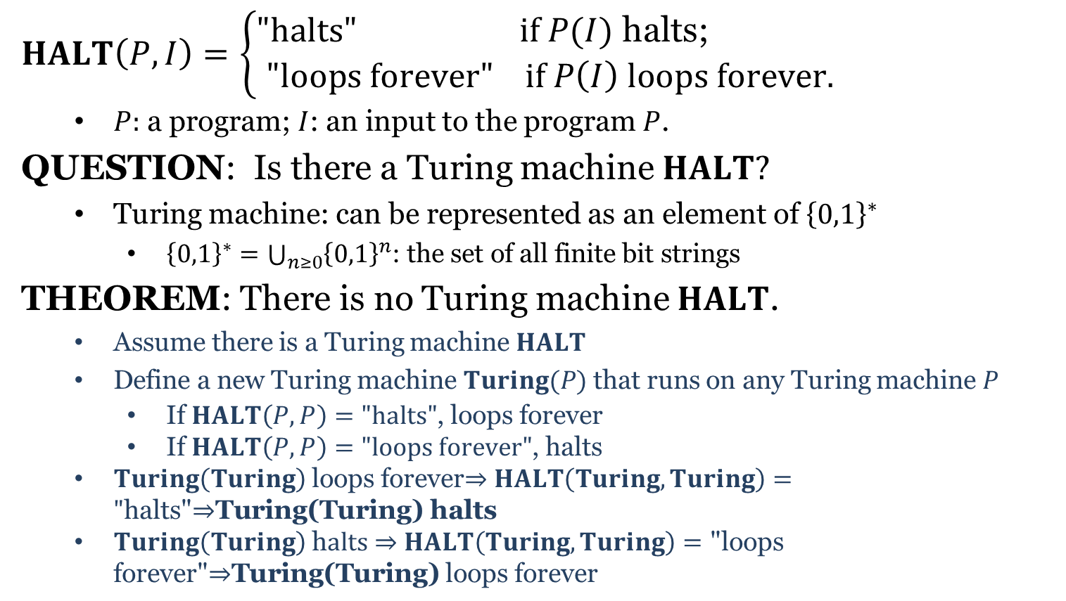
The Halting Problem
$HALT\left(P,I\right)=\left\{\begin{aligned}"halts" if P(I) \text{halts}\text{; } \\ "loops forever" if P\left(I\right) loops forever.\end{aligned}\right.$
$P:$ a program; $I$: an input to the program $P$.
QUESTION: Is there a Turing machine $HALT?$
Turing machine: can be represented as an element of ${\left\{0,1\right\}}^{∗}$
${\left\{0,1\right\}}^{∗}=\bigcup_{n≥0}{{\left\{0,1\right\}}^{n}}$: the set of all finite bit strings
THEOREM: There is no Turing machine $HALT$.
Assume there is a Turing machine $HALT$
Define a new Turing machine $Turing(P)$ that runs on any Turing machine $P$
If $HALT\left(P,P\right)="halts"$, loops forever
If $HALT\left(P,P\right)="loops forever"$, halts
$Turing\left(Turing\right)$ loops forever$⇒$ $HALT\left(Turing,Turing\right)="\text{halts}\text{"⇒}\text{Turing}\text{(}\text{Turing}\text{) }\text{halts}$
$Turing\left(Turing\right)$ h$alts⇒$ $HALT\left(Turing,Turing\right)=\text{"}\text{loops} \text{forever}\text{"⇒}\text{Turing}\text{(}\text{Turing}\text{)} \text{loops} \text{forever}$

Slide 3
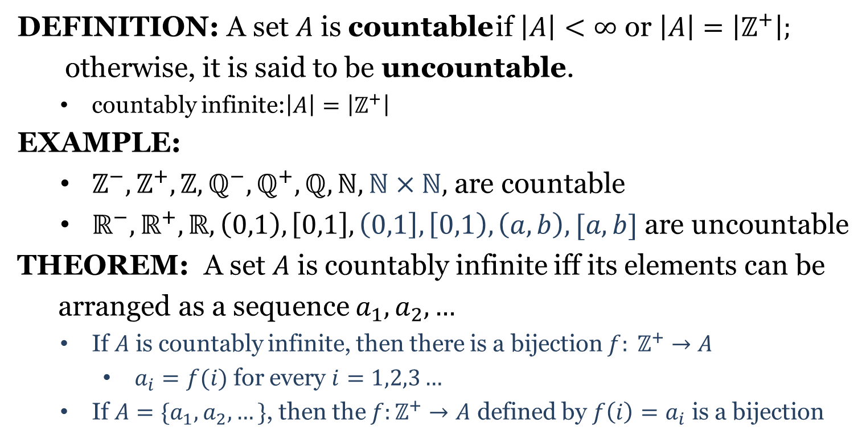
Countable and Uncountable
DEFINITION: A set $A$ is countable if $\left|A\right|<∞$ or $\left|A\right|=\left|ℤ^{+}\right|;$
otherwise, it is said to be uncountable.
countably infinite:$\left|A\right|=\left|ℤ^{+}\right|$
EXAMPLE:
$ℤ^{−},ℤ^{+}, ℤ,ℚ^{−},ℚ^{+},ℚ,ℕ,ℕ×ℕ,$ are countable
$ℝ^{−},ℝ^{+},ℝ, \left(0,1\right), \left[0,1\right],\left(0,1\right], \left[0,1\right), \left(a,b\right), [a,b]$ are uncountable
THEOREM: A set $A$ is countably infinite iff its elements can be
arranged as a sequence $a_{1},a_{2},…$
If $A$ is countably infinite, then there is a bijection $f: ℤ^{+}→A$
$a_{i}=f(i)$ for every $i=1,2,3…$
If $A=\{a_{1},a_{2},…\}$, then the $f:ℤ^{+}→A$ defined by $f\left(i\right)=a_{i}$ is a bijection

Slide 4
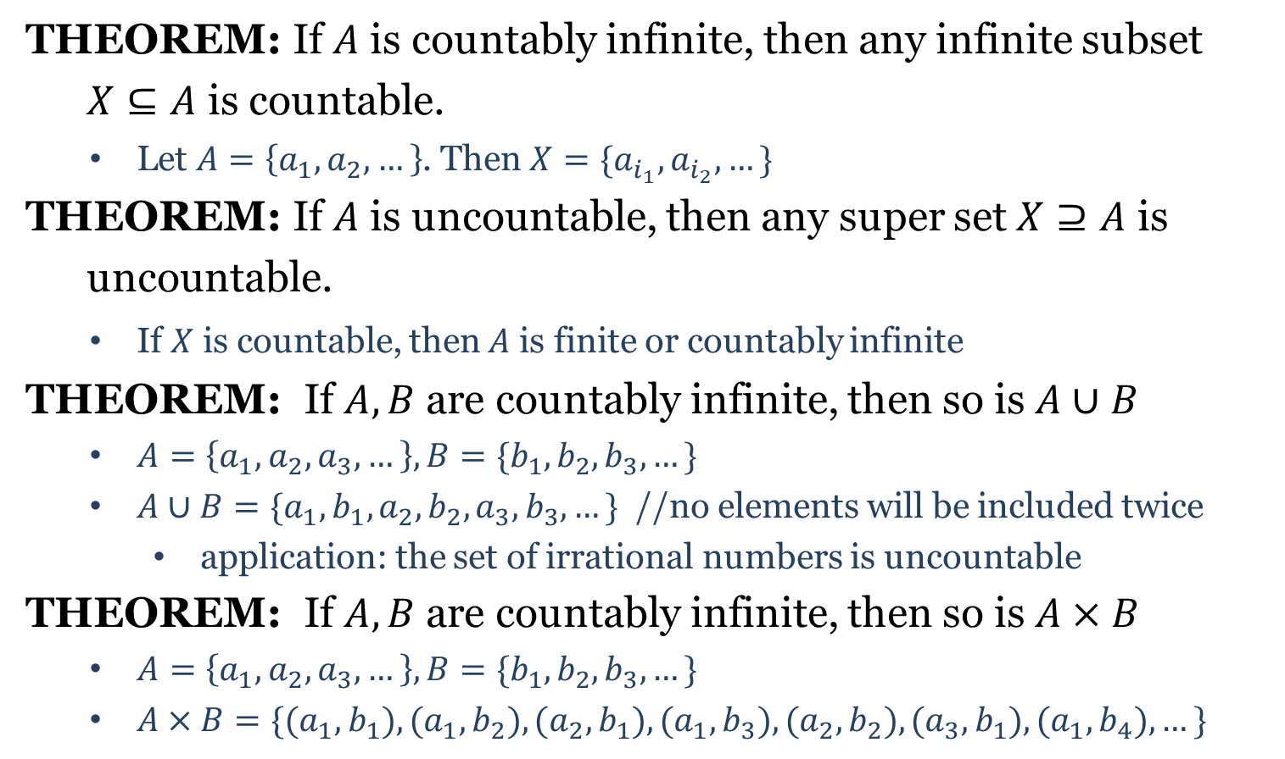

Countable and Uncountable
THEOREM: If $A$ is countably infinite, then any infinite subset
$X⊆A$ is countable.
Let $A=\left\{a_{1},a_{2},…\right\}$. Then $X=\{a_{i_{1}}, a_{i_{2}},…\}$
THEOREM: If $A$ is uncountable, then any super set$X⊇A$ is
uncountable.
If $X$ is countable, then $A$ is finite or countably infinite
THEOREM: If $A,B$ are countably infinite, then so is $A∪B$
$A=\left\{a_{1},a_{2},a_{3},…\right\}, B=\{b_{1},b_{2},b_{3},…\}$
$A∪B=\{a_{1},b_{1},a_{2},b_{2},a_{3},b_{3},…\}$ //no elements will be included twice
application: the set of irrational numbers is uncountable
THEOREM: If $A,B$ are countably infinite, then so is $A×B$
$A=\left\{a_{1},a_{2},a_{3},…\right\}, B=\{b_{1},b_{2},b_{3},…\}$
$A×B=\{(a_{1},b_{1}),(a_{1},b_{2}),(a_{2},b_{1}),(a_{1},b_{3}),(a_{2},b_{2}),(a_{3},b_{1}),(a_{1},b_{4}),…\}$
$X$ is countable

Slide 5
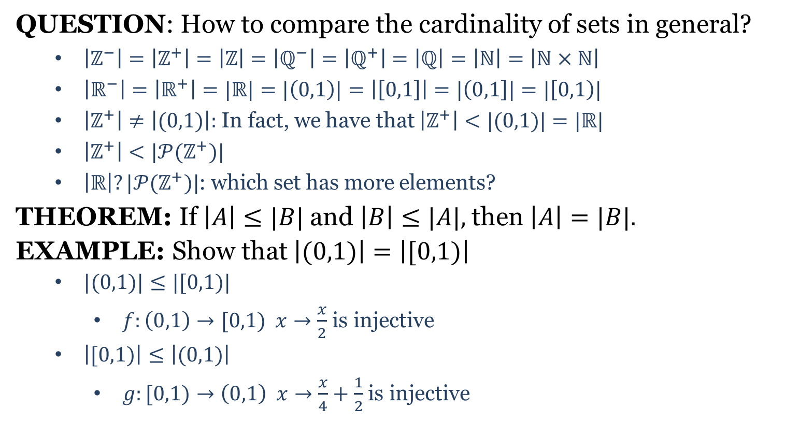
Schröder-Bernstein Theorem
QUESTION: How to compare the cardinality of sets in general?
$\left|ℤ^{−}\right|=\left|ℤ^{+}\right|=\left|ℤ\right|=\left|ℚ^{−}\right|=\left|ℚ^{+}\right|=\left|ℚ\right|=\left|ℕ\right|=\left|ℕ×ℕ\right|$
$\left|ℝ^{−}\right|=\left|ℝ^{+}\right|=|ℝ|=|\left(0,1\right)|=\left|\left[0,1\right]\right|=|\left(0,1\right]|=|\left[0,1\right)|$
$\left|ℤ^{+}\right|≠\left|(0,1)\right|:$ In fact, we have that $\left|ℤ^{+}\right|<|(0,1)|$ $=|ℝ|$
$\left|ℤ^{+}\right|<|𝒫(ℤ^{+})|$
$\left|ℝ\right|?|𝒫(ℤ^{+})|$: which set has more elements?
THEOREM: If $\left|A\right|≤|B|$and $\left|B\right|≤|A|,$then $\left|A\right|=|B|.$
EXAMPLE: Show that $\left|(0,1)\right|=\left|[0,1)\right|$
$|(0,1)|≤|[0,1)|$
$f:\left(0,1\right)→[0,1) x→\frac{x}{2}$ is injective
$\left|[0,1)\right|≤\left|(0,1)\right|$
$g:[0,1)→\left(0,1\right) x→\frac{x}{4}+\frac{1}{2}$ is injective

Slide 6
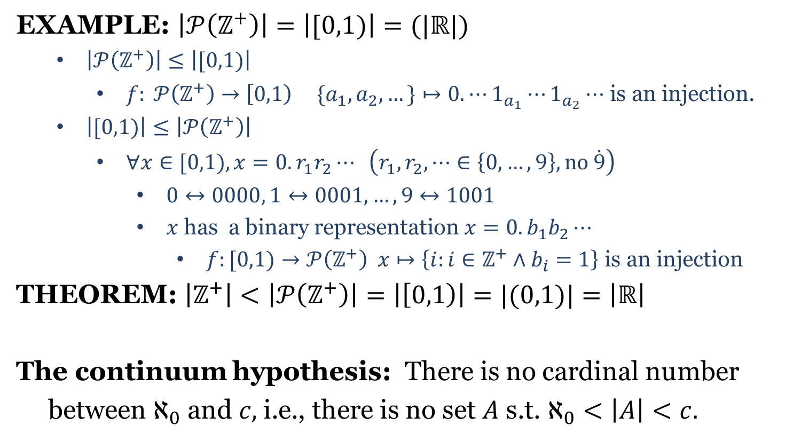



Schröder-Bernstein Theorem
EXAMPLE: $\left|𝒫\left(ℤ^{+}\right)\right|=\left|[0,1)\right|=(|ℝ|)$
$\left|𝒫\left(ℤ^{+}\right)\right|≤\left|[0,1)\right|$
$f: 𝒫\left(ℤ^{+}\right)→\left[0,1\right) \{a_{1},a_{2},…\}↦0. ⋯1_{a_{1}}⋯1_{a_{2}}⋯$ is an injection.
$\left|[0,1)\right|≤\left|𝒫\left(ℤ^{+}\right)\right|$
$∀x∈[0,1), x=0.r_{1}r_{2}⋯ \left(r_{1},r_{2},⋯∈\left\{0,…,9\right\}, no \dot{9}\right)$
$0↔0000, 1↔0001,…,9↔1001$
$x$ has a binary representation $x=0.b_{1}b_{2}⋯$
$f:[0,1)→𝒫\left(ℤ^{+}\right) x↦\left\{i:i∈ℤ^{+}∧b_{i}=1\right\}$ is an injection
THEOREM: $\left|ℤ^{+}\right|<\left|𝒫\left(ℤ^{+}\right)\right|=\left|\left[0,1\right)\right|=|(0,1)|=\left|ℝ\right|$
The continuum hypothesis: There is no cardinal number
between $ℵ_{0}$ and $c,$i.e., there is no set $A$ s.t. $ℵ_{0}<\left|A\right|<c.$
$$ℵ_{0}$$
$$2^{ℵ_{0}}$$
$$c$$

Slide 8
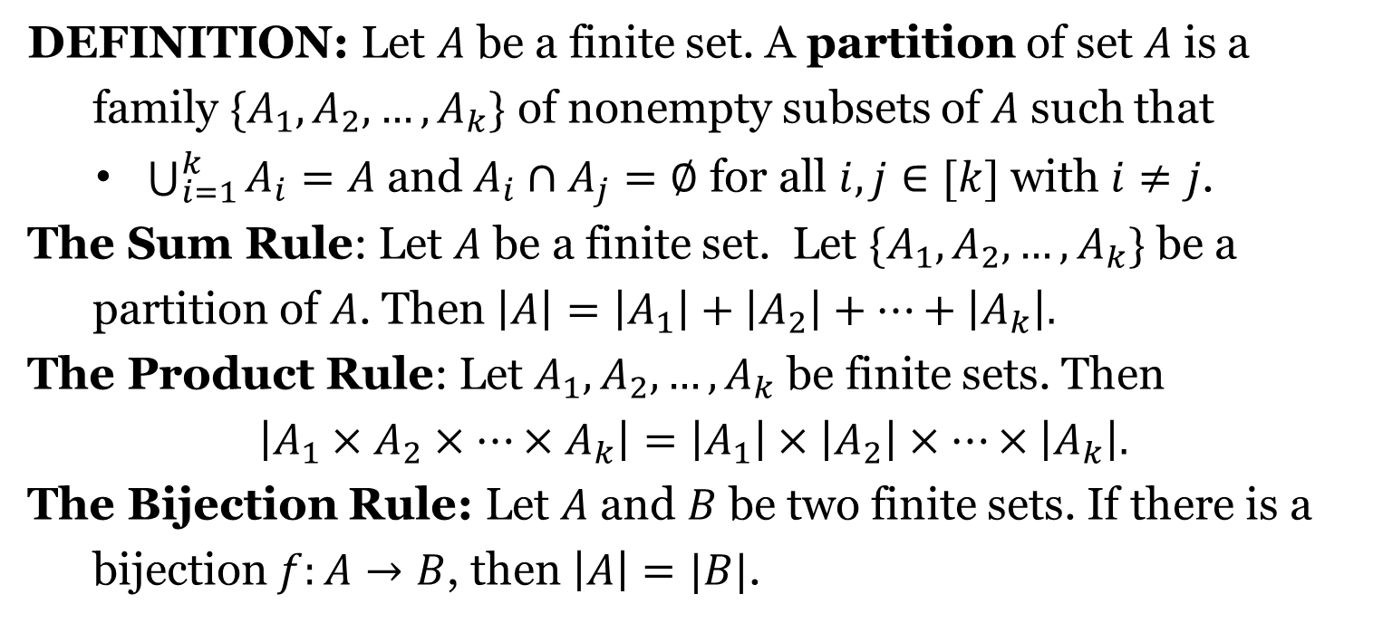
Basic Rules of Counting
DEFINITION: Let $A$ be a finite set. A partition of set $A$ is a
family $\{A_{1},A_{2},…,A_{k}\}$ of nonempty subsets of $A$ such that
$\bigcup_{i=1}^{k}{A_{i}=A}$ and $A_{i}∩A_{j}=∅$ for all $i,j∈[k]$ with $i≠j$.
The Sum Rule: Let $A$ be a finite set. Let $\{A_{1},A_{2},…,A_{k}\}$ be a
partition of $A$. Then $\left|A\right|=\left|A_{1}\right|+\left|A_{2}\right|+⋯+\left|A_{k}\right|.$
The Product Rule: Let $A_{1},A_{2},…,A_{k}$ be finite sets. Then
$$\left|A_{1}×A_{2}×⋯×A_{k}\right|=\left|A_{1}\right|×\left|A_{2}\right|×⋯×\left|A_{k}\right|.$$
The Bijection Rule: Let $A$ and $B$ be two finite sets. If there is a
bijection $f:A→B$, then $\left|A\right|=|B|$.

Slide 9
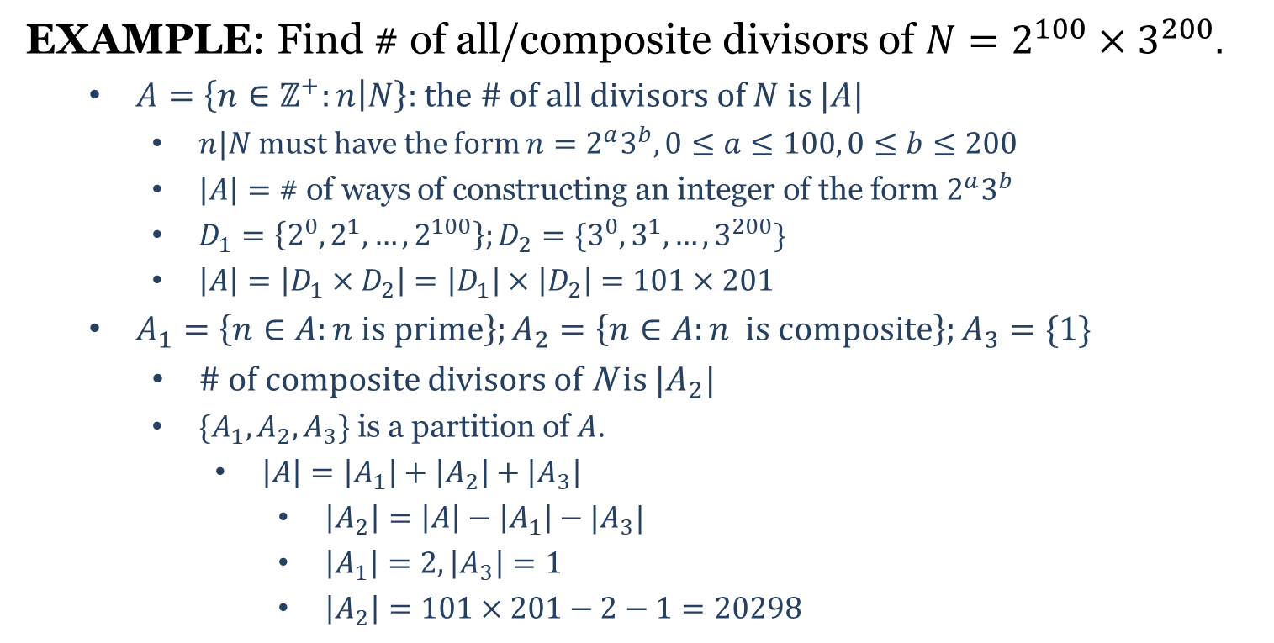
Basic Rules of Counting
EXAMPLE: Find # of all/composite divisors of $N=2^{100}×3^{200}.$
$A=\left\{n∈ℤ^{+}:n | N\right\}:$ the # of all divisors of $N$ is $|A|$
$n|N$ must have the form $n=2^{a}3^{b}, 0≤a≤100, 0≤b≤200$
$\left|A\right|=$ # of ways of constructing an integer of the form $2^{a}3^{b}$
$D_{1}=\left\{2^{0},2^{1},…,2^{100}\right\};D_{2}=\{3^{0},3^{1},…,3^{200}\}$
$\left|A\right|=\left|D_{1}×D_{2}\right|=\left|D_{1}\right|×\left|D_{2}\right|=101×201$
$A_{1}=\left\{n∈A:n is prime\right\};A_{2}=\left\{n∈A:n is composite\right\};A_{3}=\{1\}$
# of composite divisors of N is $|A_{2}|$
$\{A_{1},A_{2},A_{3}\}$ is a partition of $A$.
$\left|A\right|=\left|A_{1}\right|+\left|A_{2}\right|+\left|A_{3}\right|$
$\left|A_{2}\right|=\left|A\right|−\left|A_{1}\right|−|A_{3}|$
$\left|A_{1}\right|=2, \left|A_{3}\right|=1$
$\left|A_{2}\right|=101×201−2−1=20298$

Slide 11
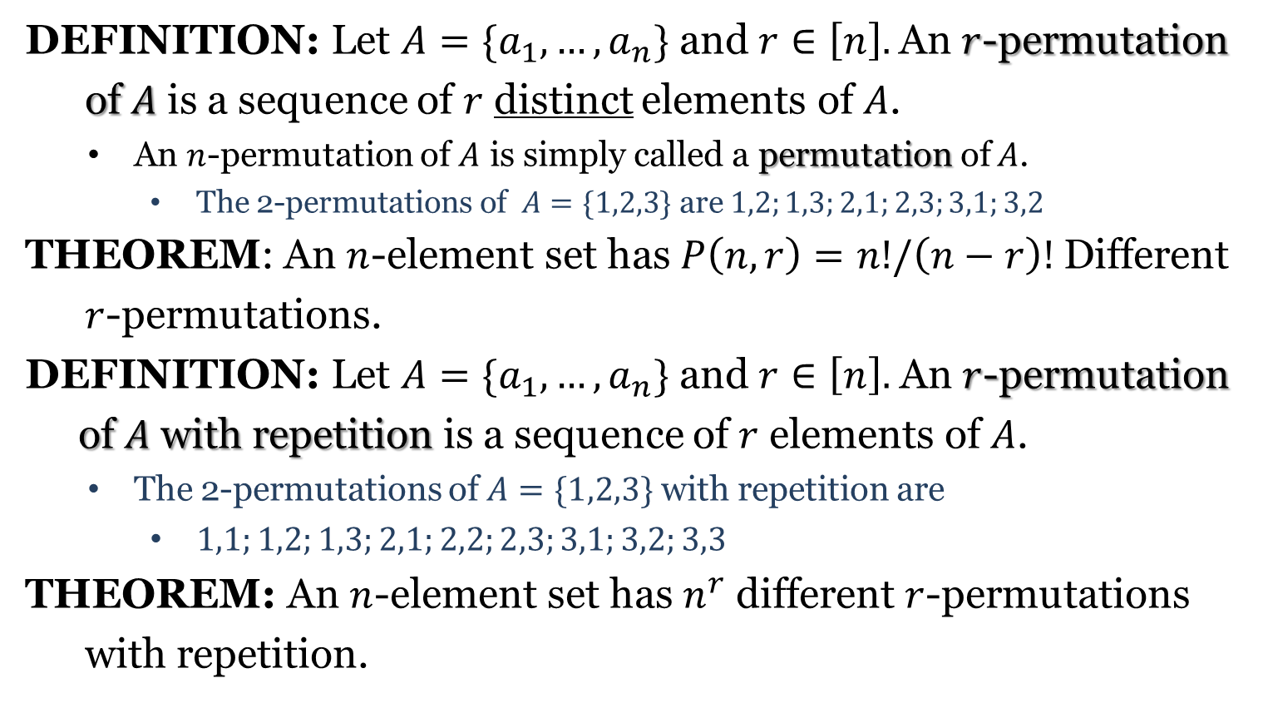
Permutations of Set
DEFINITION: Let $A=\{a_{1}, …,a_{n}\}$ and $r∈\left[n\right].$An $r$-permutation
of $A$ is a sequence of $r$ distinct elements of $A$.
An $n$-permutation of $A$ is simply called a permutation of $A$.
The 2-permutations of $A=\{1,2,3\}$ are $1,2;1,3;2,1;2,3;3,1;3,2$
THEOREM: An $n$-element set has $P\left(n,r\right)=n!/\left(n−r\right)!$ Different
$r$-permutations.
DEFINITION: Let $A=\{a_{1}, …,a_{n}\}$ and $r∈\left[n\right].$ An $r$-permutation
of $A$ with repetition is a sequence of $r$ elements of $A$.
The 2-permutations of $A=\{1,2,3\}$ with repetition are
$1,1;1,2;1,3;2,1;2,2;2,3;3,1;3,2;3,3$
THEOREM: An $n$-element set has $n^{r}$ different $r$-permutations
with repetition.

Slide 12
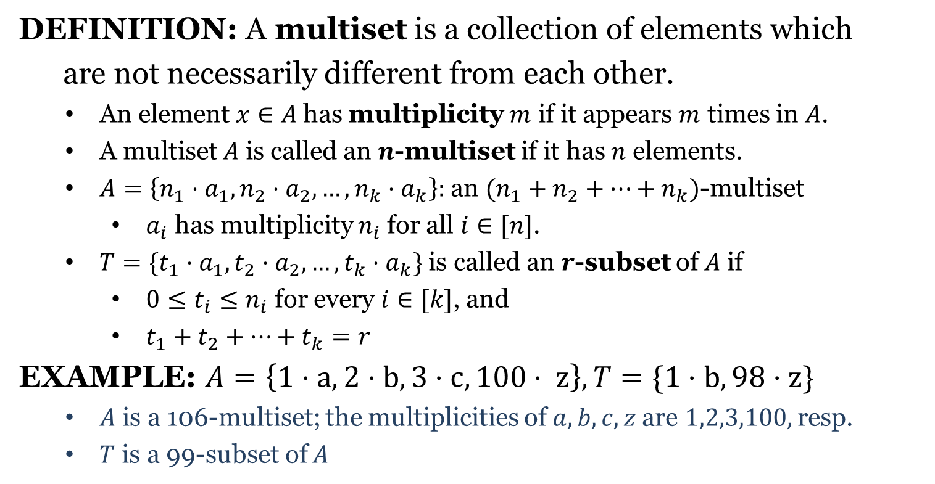
Multiset
DEFINITION: A multiset is a collection of elements which
are not necessarily different from each other.
An element $x∈A$ has multiplicity $m$ if it appears $m$ times in $A$.
A multiset $A$ is called an $n$-multiset if it has $n$ elements.
$A=\left\{n_{1}⋅a_{1}, n_{2}⋅a_{2},…,n_{k}⋅a_{k}\right\}:$ an $(n_{1}+n_{2}+⋯+n_{k})$-multiset
$a_{i}$ has multiplicity $n_{i}$ for all $i∈[n]$.
$T=\{t_{1}⋅a_{1},t_{2}⋅a_{2},…,t_{k}⋅a_{k}\}$ is called an $r$-subset of $A$ if
$0≤t_{i}≤n_{i}$ for every $i∈[k]$, and
$t_{1}+t_{2}+⋯+t_{k}=r$
EXAMPLE: $A=\left\{1⋅a,2⋅b, 3⋅c, 100⋅ z\right\}, T=\{1⋅b, 98⋅z\}$
$A$ is a 106-multiset; the multiplicities of $a,b,c,z$ are $1,2,3,100,$ resp.
$T$ is a 99-subset of $A$

Slide 13
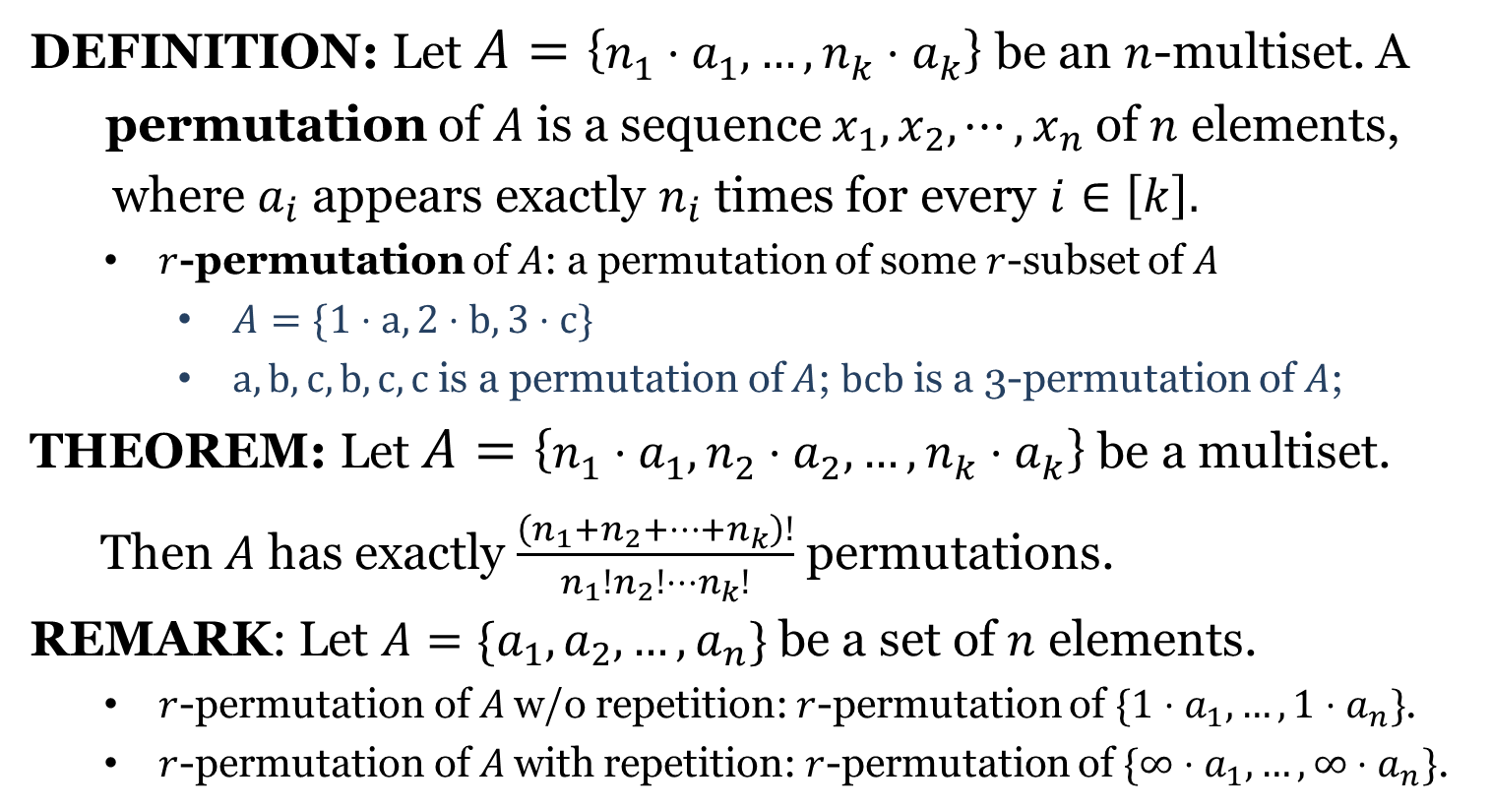
Permutations of Multiset
DEFINITION: Let $A=\left\{n_{1}⋅a_{1},…,n_{k}⋅a_{k}\right\}$ be an $n$-multiset. A
permutation of $A$ is a sequence $x_{1},x_{2},⋯,x_{n}$ of $n$ elements,
where $a_{i}$ appears exactly $n_{i}$ times for every $i∈\left[k\right].$
$r$-permutation of $A$: a permutation of some $r$-subset of $A$
$A=\{1⋅a, 2⋅b, 3⋅c\}$
$a,b,c,b,c,c$ is a permutation of $A$; $bcb$ is a 3-permutation of $A$;
THEOREM: Let $A=\left\{n_{1}⋅a_{1}, n_{2}⋅a_{2},…,n_{k}⋅a_{k}\right\}$ be a multiset.
Then $A$ has exactly $\frac{\left(n_{1}+n_{2}+⋯+n_{k}\right)!}{n_{1}!n_{2}!⋯n_{k}!}$ permutations.
REMARK: Let $A=\{a_{1},a_{2},…,a_{n}\}$ be a set of $n$ elements.
$r$-permutation of $A$ w/o repetition: $r$-permutation of $\{1⋅a_{1}, …,1⋅a_{n}\}$.
$r$-permutation of $A$ with repetition: $r$-permutation of $\{∞⋅a_{1}, …,∞⋅a_{n}\}$.

Slide 15

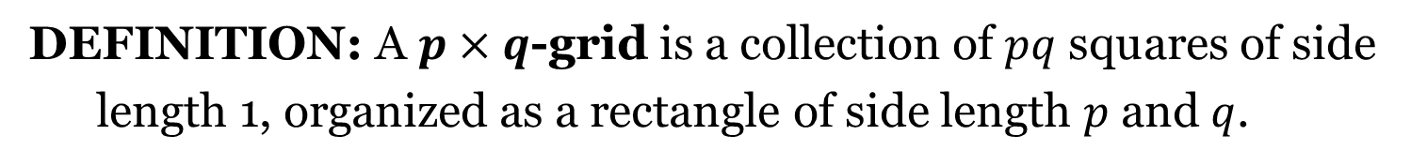

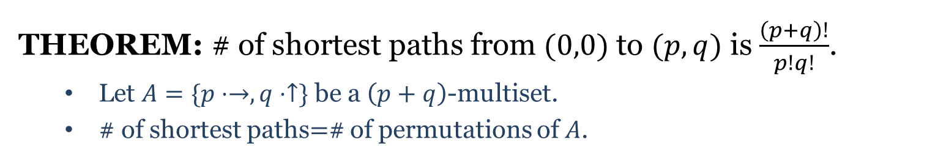


Shortest Path
DEFINITION: A $p×q$-grid is a collection of $pq$ squares of side
length 1, organized as a rectangle of side length $p$ and $q$.
$$q=5$$
$$(p,q)$$
$$(0,0)$$
$$p=7$$
THEOREM: # of shortest paths from $(0,0)$ to $(p,q)$ is $\frac{\left(p+q\right)!}{p!q!}$.
Let $A=\{p⋅→, q⋅↑\}$ be a $\left(p+q\right)$-multiset.
# of shortest paths$=$# of permutations of $A$.

Slide 16
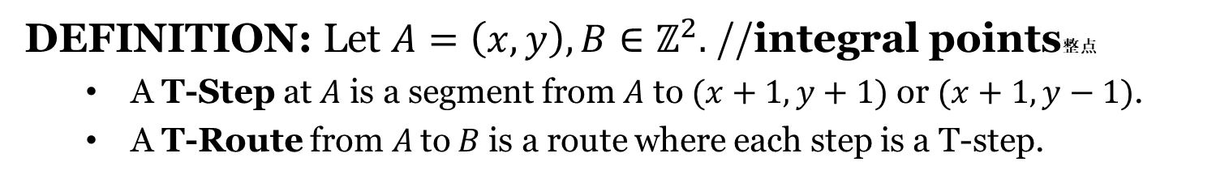




T-Route
DEFINITION: Let $A=\left(x,y\right), B∈ℤ^{2}.$ //integral points整点
A T-Step at $A$ is a segment from $A$ to $(x+1,y+1)$ or $(x+1,y−1)$.
A T-Route from$A$to $B$ is a route where each step is a T-step.
$$q=5$$
$$(p,q)$$
$$(0,0)$$
$$p=7$$

